Slide 1

Welcome
Global health
Session 9
Dr. Tilly Paz

Slide 2
Notes on your essay
Introduction – short, and an essay outline
Clear case (problem, not solutions!), place, year(s)… Don’t define GH or talk about GH themes (what)
Local – don’t repeat the “what happened” (why, not what), not the issue but the place, the people, why they were susceptible or exposed or at risk, local healthcare systems and health investment
Global – again, not the what buy the why, climate change, globalisation, other countries, trade and aid, global agencies or partnerships
Intervention - clear actions, not a general logic, year(s), who was involved, plan, aims, no background (what), description and evaluation (of what went well or wrong)
SDGs – don’t mix it elsewhere, focus on main 2-3 relevant ones, don’t explain in length about the SDGs (what)
Lessons & countries – main lessons (why it worked or not), and main points re other 2 countries as to why it would work with the same problem (the similarities of the case and the country) or not (the differences)
Conclusion – repeat the main learning of this case
Follow the structure!; Use professional terminology (CD? NCD?); Aspire for high quality refs Come next week with 1 page, bullet points, or you won’t get feedback…keep your instructions and references elsewhere

Slide 3

In this session you will:
Define key terms related to nutrition
Discuss nutrition needs at different stages of the life course
Discuss the burden of nutrition problems globally
Discuss measures that can be taken to address key nutrition concerns

Slide 4
Definitions and Key Terms
Malnutrition: refers to those who do not get proper nutrition, whether too little, too much, or the wrong kind
The expression of undernutrition in children: the three most commonly used indices for child undernutrition are height-for-age, weight-for-age, and (weight-for-height)
Stunting: failure to reach linear growth potential because of inadequate nutrition or poor health. Stunting is measured as height-for-age two z-scores below the international reference
Wasting: weight, measured in kilograms, divided by height in meters squared, that is two z-scores below the international reference
Overweight: excess weight relative to height; commonly measured by BMI among adults. The international reference for adults is as follows:
25–29.99 for grade I (overweight) ; 30–39.99 for grade II (obese) ; > 40 for grade III
For children, overweight is measured as weight-for-height two z-scores above the international reference

Slide 5
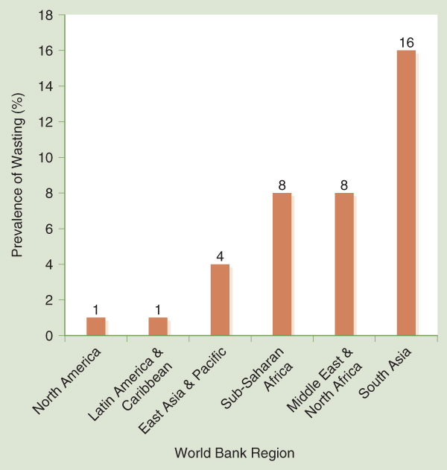
Nutritional State of the World
Data from The World Bank. (n.d.). Data: Prevalence of wasting, weight for height (% of children under 5). Retrieved from https://data.worldbank.org/indicator/SH.STA.WAST.ZS?view=chart

Slide 6
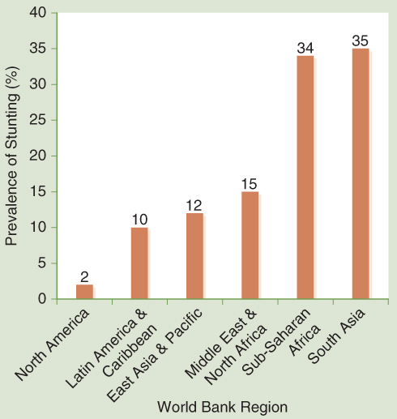
Nutritional State of the World
Data from The World Bank. (n.d.). Data: Prevalence of stunting, height for age (% of children under 5). Retrieved from https://data.worldbank.org/indicator/SH.STA.STNT.ZS?view=chart

Slide 7
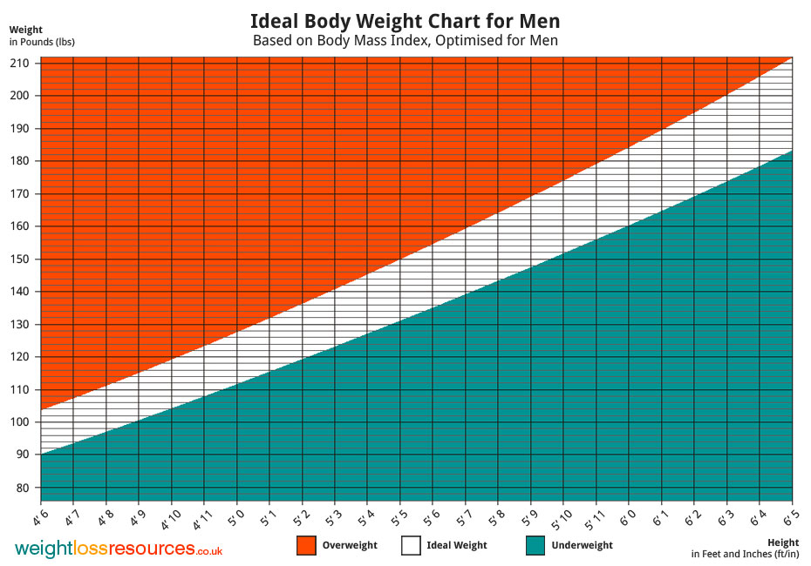
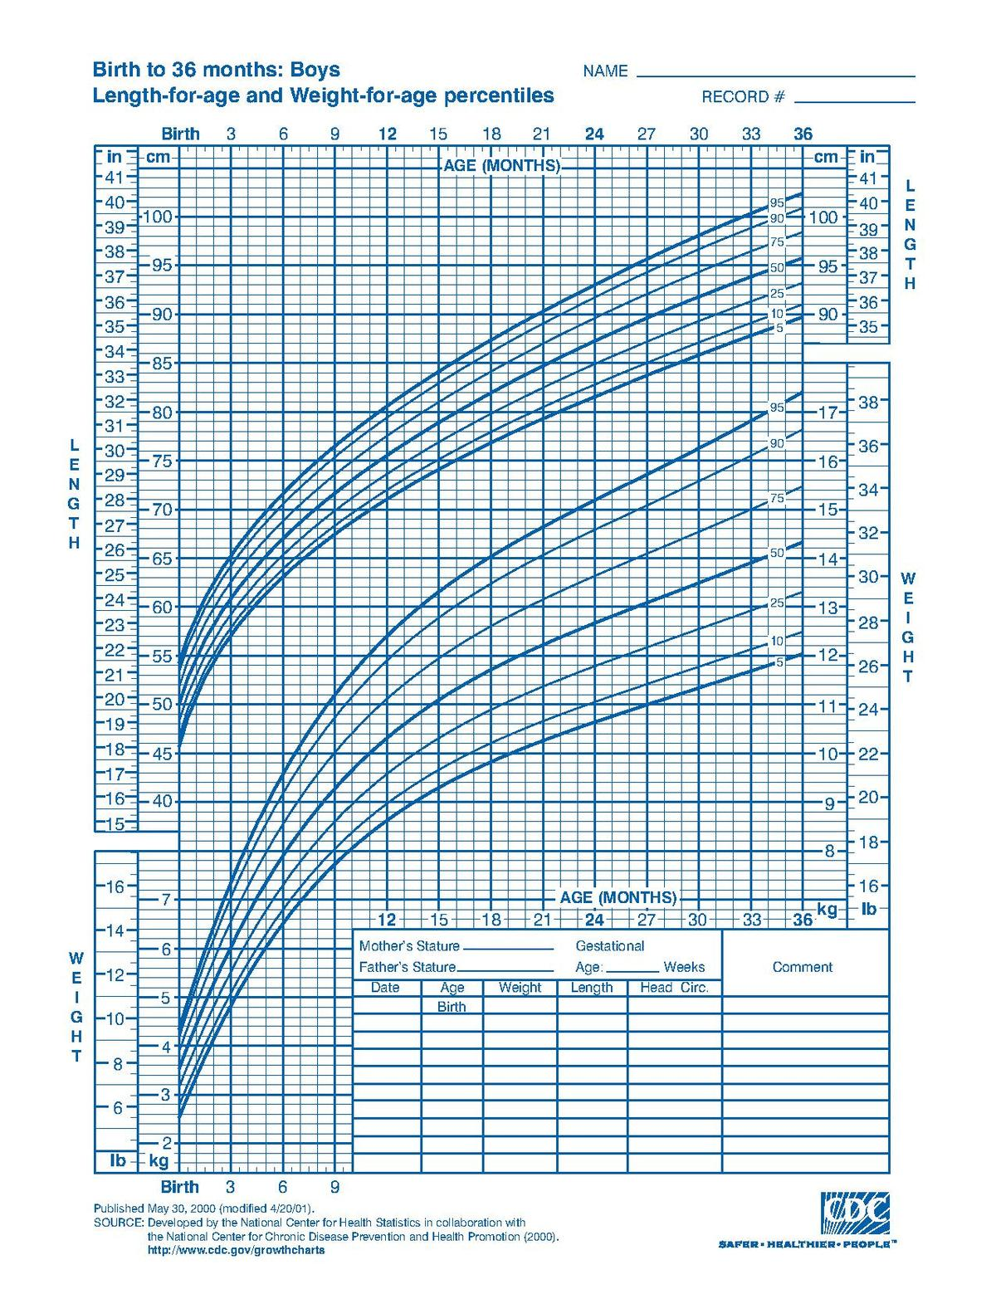


Slide 8
The Importance of Nutrition
In LICS & MICS, 45% of all child death are attributable to nutrition related causes (in 2017 it was 2.4 million deaths for a year, which means 7000 a day)
Low birthweight is the 2nd leading risk factor globally for child death under 5 years old, child wasting is the 3rd, child underweight is 5th, vitamin A deficiency is 9th, and child stunting is 10th
Nearly 31% of the world’s population is overweight or obese; most of these people are in low- and middle-income countries
Overweight and obesity are closely linked with many noncommunicable diseases, and prevention is complex
Nutrition is central to achievement of the SDGs
Low-cost, highly effective interventions are available to improve nutrition status

Slide 9
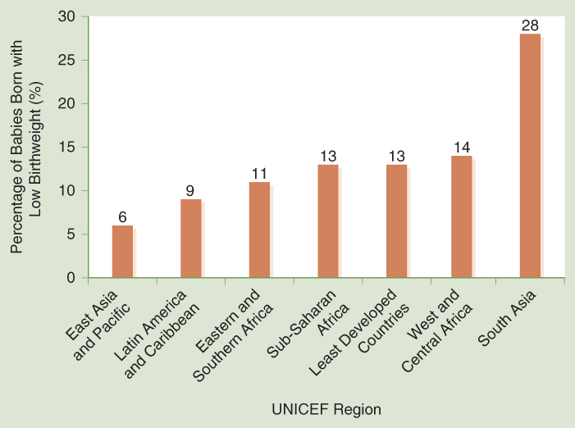
Nutritional State of the World
Low Birthweight
Low birthweight: babies born under 2,500 grams
Data from World Health Organization (WHO). (2014). Global nutrition targets 2025: Low birth weight policy brief. Geneva, Switzerland: Author. Retrieved from http://apps.who.int/iris/bitstream/handle/10665/149020/WHO_NMH_NHD_14.5_eng.pdf?ua=1

Slide 10
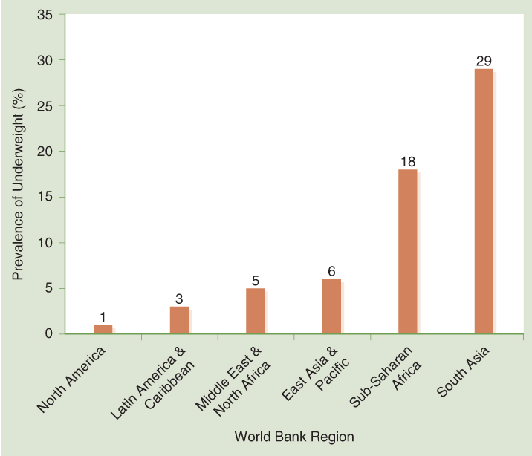
Nutritional State of the World
Data from The World Bank. (n.d.). Data: Prevalence of underweight, weight for age (% of children under 5). Retrieved from https://data.worldbank.org/indicator/SH.STA.MALN.ZS

Slide 11

17 GOALS: Which are linked with nutrition? How strong is the link (1-10)?
Notes:
The SDG images are from the United Nations.
Guidelines for use: http://www.un.org/sustainabledevelopment/wp-content/uploads/2016/09/UN-Guidelines-for-Use-of-SDG-logo-and-17-icons.September-2016.pdf

Slide 12
The Determinants of Nutritional Status
Undernutrition
Immediate causes:
Inadequate dietary intake: weakens the body and opens it up to infection
Illness: makes it harder for people to eat, absorb the nutrients they take in, and raises the need for some nutrients (some pickiness as well, for example – iron deficiency, less appetite, sometimes specifically for iron rich foods)
This relationship creates a cycle of illness and infection

Slide 13
The Determinants of Nutritional Status
Overweight and Obesity
Most immediate cause is an increase in total energy intake coupled with a decrease in energy expenditure (what other reasons can you recall from E&H)
Genetic and cultural factors are important
Rising global rate of obesity is being driven by global financial and trade liberalization, increased income and socioeconomic status, and urbanization

Slide 14
What do we know?
Use the space to add your knowledge to the topics:
Underweight / Overweight
Follow these three streams of categories:
Life course approach (babies, infants, young children, adolescents, adults, elderly)
Gender gap (men, women)
Economic development (developed countries, developing countries)

Slide 15
Nutritional Needs Throughout the Life Cycle
Pregnancy and Birthweight
Pregnant women need a sufficient amount of protein and energy and should consume 300 more calories a day
Iron, iodine, folate, zinc, and calcium are also important to the health of the woman and child
The birthweight of a baby is an extremely important determinant of the extent to which a child will thrive and become a healthy adult

Slide 16
Nutritional Needs Throughout the Life Cycle
Infancy and Young Childhood
“Window of opportunity” is conception to 2 years of age
Nutritional gaps during this time can cause problems with stature, mental development, and frequent infection
Children need sufficient protein, energy, and fats as well as iodine, iron, vitamin A, and zinc
Children grow best and stay healthiest if exclusively breastfed for first 6 months
Nutritional status of infants and children is gauged by measuring and weighing them, then plotting weight and height on a growth chart
Child’s position on growth curve indicates whether growth is normal
Large share of nutritional deficits are mild, but still have negative consequences on development
Birthweight—a child has a low birthweight if the child’s weight at birth is below 2,500 grams
Height-for-age—a child is stunted if its height-for age is two z-scores below the international reference height-for-age
Weight-for-age—a child is underweight if its weight is two z-scores below the international reference weight-for-age

Slide 17
Gauging Nutritional Status
Children
Nutritional status of infants and children is gauged by measuring and weighing them, then plotting weight and height on a growth chart
Child’s position on growth curve indicates whether growth is normal
Large share of nutritional deficits are mild, but still have negative consequences on development
Birthweight—a child has a low birthweight if the child’s weight at birth is below 2,500 grams
Height-for-age—a child is stunted if its height-for age is two z-scores below the international reference height-for-age
Weight-for-age—a child is underweight if its weight is two z-scores below the international reference weight-for-age

Slide 18
Nutritional Needs Throughout the Life Cycle
Adolescence
Adolescents need protein and energy to grow, as well as iron, iodine, folic acid, and calcium
Adolescent girls who are poorly nourished are much more likely to give birth to an underweight child and experience complications during pregnancy than well-nourished girls
Children who are stunted are generally unable to make up later for their hindered growth

Slide 19
Nutritional Needs Throughout the Life Cycle
Adulthood and Old Age
Adults need a well-balanced diet with protein, energy, and iron in order to stay productive
Foods that contain too much fat, cholesterol, sugar, or salt can be harmful
The ability of older people to live on their own can depend on their nutritional status
Older adults need calcium to reduce risk of osteoporosis

Slide 20
Key nutritional needs and how to meet them
Listen to the short cases
What is needed? (try and spot as many nutritional needs as possible)
How can we provide/encourage that need being met?
Is it a quick win or a difficult/complex solution?

Slide 21
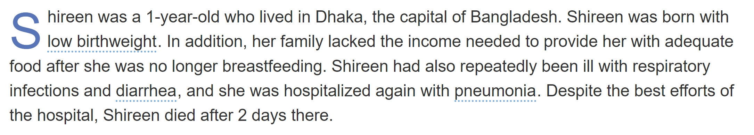

Slide 22
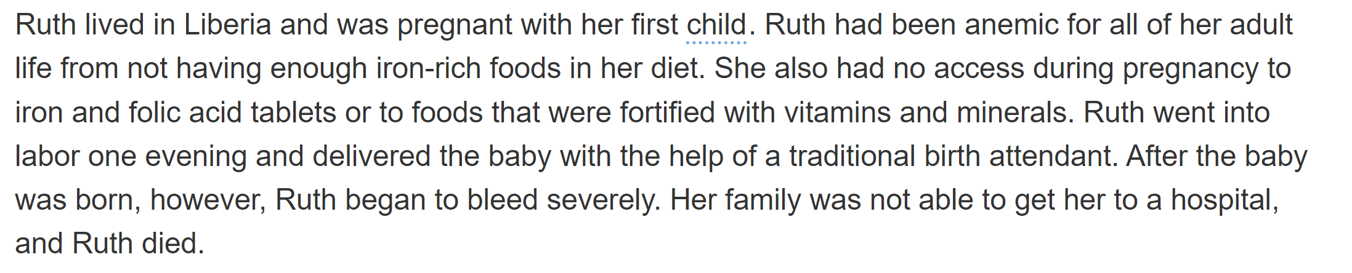

Slide 23
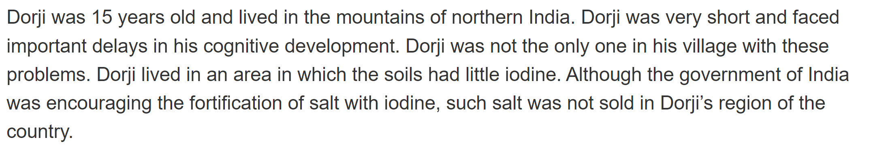

Slide 24
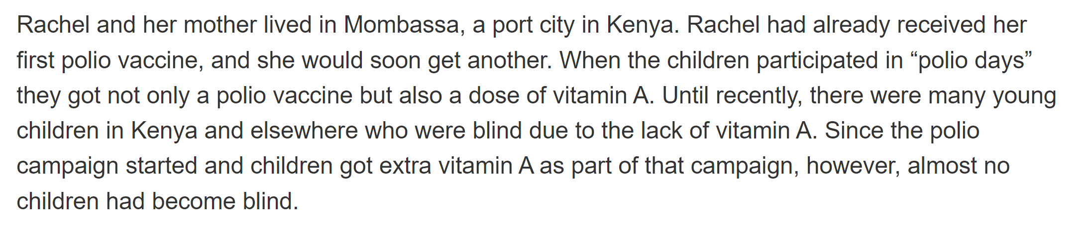

Slide 25
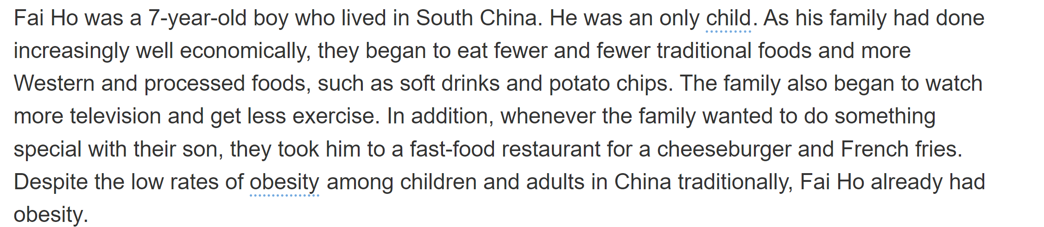

Slide 26
Key Nutritional Needs
Vitamin A
Found mostly in green leafy vegetables, yellow and orange fruits that are not citrus, and carrots
Deficiency associated with xeropthalmia, eventually can lead to permanent blindness
Important to growth and proper functioning of immune system; can impact severity of illness and chance of survival of pneumonia, diarrhea, and measles
Supplement as a shot, encourage better nutrition, fortify foods

Slide 27
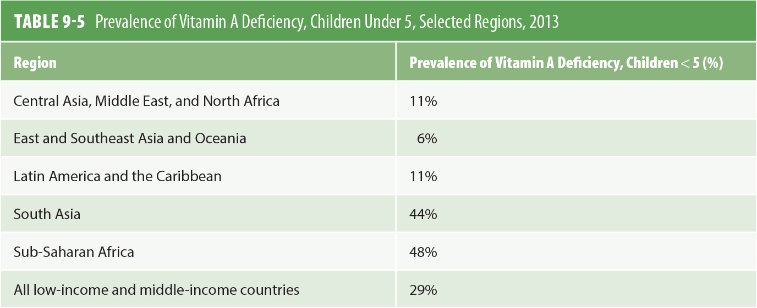
Nutritional State of the World
Data from Stevens, G. A., Bennett, J. E., Hennocq, Q., Lu, Y., De-Regil, L. M., Rogers, L., . . . Ezzati, M. (2015). Trends and mortality effects of vitamin A deficiency in children in 138 low-income and middle-income countries between 1991 and 2013: A pooled analysis of population-based surveys. Lancet Global Health, 3(9), e528–e536. doi: https://doi.org/10.1016/S2214-109X(15)00039-X

Slide 28
Key Nutritional Needs
Iodine
Found in some types of seafood and in plants that are grown in soil that naturally contains iodine
Deficiency associated with a growth on the thyroid called a goiter and the failure to develop full intellectual potential
Often occurs in people who live in mountainous regions where less seafood is consumed, and the soil is deficient in iodine
Fortify salt

Slide 29
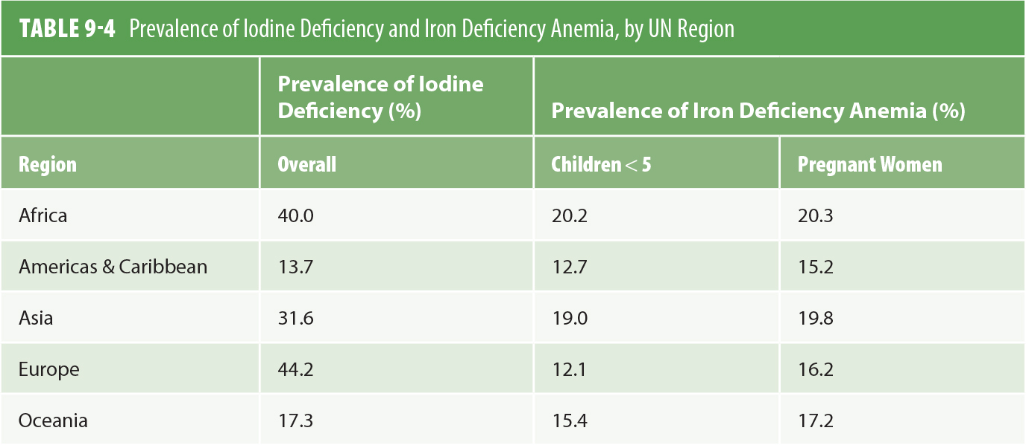
Nutritional State of the World
Data from Black, R. E., Victora, C. G., Walker, S. P., Bhutta, Z. A., Christian, P., de Onis, M., . . . Uauy, R. (2013). Maternal and child undernutrition and overweight in low-income and middle-income countries. Lancet, 382(9890), 427–451.

Slide 30
Key Nutritional Needs
Iron
Found most easily in fish, meat, poultry; also in fruits, grains, vegetables, nuts, and dried beans
Lack of iron associated with iron deficiency anemia, associated with fatigue and weakness
Iron-deficient pregnant women have an increased risk of giving birth to a premature or low birthweight baby, or hemorrhaging and dying in child birth
Encourage specific foods, supplement and fortify

Slide 31
Key Nutritional Needs
Zinc
Best sources in red and white meat and shellfish
Severe deficiency is associated with growth restriction, impaired immune function, skin disorders, hypogonadism, and cognitive dysfunction
Deficiency is a major risk factor for morbidity and mortality from diarrhea, pneumonia, and malaria
Encourage better and more specific nutrition, provide supplements

Slide 32
Key Nutritional Needs
Folic Acid and Calcium
Folic acid is primarily found in leafy green vegetables and in enriched products, such as flour
Calcium is generally found in dairy products
Deficiencies of folic acid in pregnant women are associated with neural tube defects in their children, such as spina bifida
Supplementation with calcium reduces the risk of hypertensive disorders of pregnancy

Slide 33
Key Nutritional Needs
Sodium
Sodium is found in high quantities in restaurant and processed foods
High sodium intake can lead to hypertension, which is a major risk factor for stroke and fatal coronary heart disease
Evidence suggests that sodium intake should be limited to 1.7 grams per day (less than 5 grams of salt a day)
Lower the consumption of salt. Can you spot the clash?

Slide 34
Key Nutritional Needs
Dietary Fiber and Refined Carbohydrates
Sources of dietary fibers include whole grains, legumes, fruits, and vegetables
Dietary fiber helps prevent obesity, diabetes, cardiovascular diseases, and various cancers
Whole grains are often processed to produce refined carbohydrates, which removes the majority of the fibers and other nutrients
Encourage the consumption of whole grains through subsidies

Slide 35
Nutritional State of the World
Overweight and Obesity
Nearly 31% of the world’s population, 2.3 billion people, are obese or overweight
Obesity has nearly doubled worldwide since 1980
Childhood obesity has emerged as one of the most serious public health challenges of the 21st century
The U.S. has the highest proportion of the world’s obese people (13%)

Slide 36
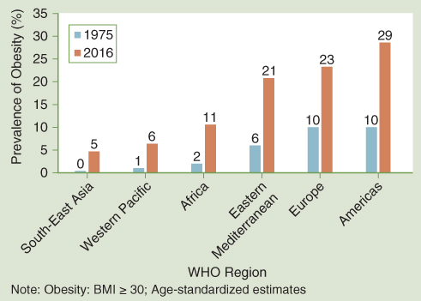
Nutritional State of the World
Data from World Health Organization (WHO). (2017). Prevalence of obesity among adults, BMI ≥ 30, age-standardized. Retrieved from http://apps.who.int/gho/data/view.main.REGION2480A?lang=en

Slide 37
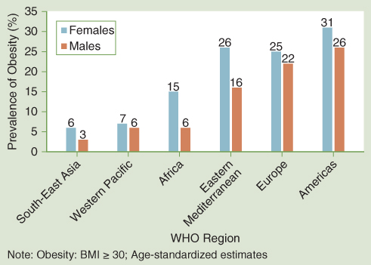
Nutritional State of the World
Data from World Health Organization (WHO). (2017). Prevalence of obesity among adults, BMI ≥ 30, age-standardized. Retrieved
from http://apps.who.int/gho/data/view.main.REGION2480A?lang=en

Slide 38
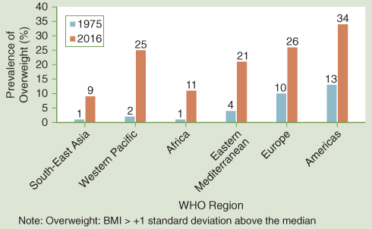
Nutritional State of the World
Data from World Health Organization (WHO). (2016). Prevalence of overweight among children and adolescents, BMI > +1 standard deviation above the median, crude. Retrieved from http://apps.who.int/gho/data/view.main.BMIPLUS1CREGv?lang=en

Slide 39
Addressing Future Nutrition Challenges
Policy makers need to understand the exceptional importance of nutrition to good health and human productivity and act accordingly
Governments need to work with the food industry to improve the way in which foods are fortified and to be sure that processed foods are healthy
Further research on what works
Create partnerships of civil society, government, and the private sector
Nutrition-specific interventions—those interventions that can have a direct impact on nutrition
Examples: promotion of exclusive breastfeeding, micronutrient supplementation, and food fortification
Nutrition-sensitive interventions—those interventions that address the underlying determinants of malnutrition
Examples: vaccination program or nutrition programs to enable farmers to increase the yield of crops that they consume

Slide 40
Addressing Future Nutrition Challenges
The enabling environment for nutrition—this concerns laws, policies, resources, and institutional issues that relate to the approach countries take to nutrition and how effective they are at formulating, implementing, and monitoring nutrition interventions
Examples: taxing sweetened beverages or foods high in fat

Slide 41
Sort them right
With the next slides, try and sort the intervention from the lowest to the highest in how easy it is to implement them. Keep record of your arguments.
Think of the differences in cost and implementation of: communication efforts (exclusive breastfeeding, safe introduction of foods; choosing nutritious foods)
Fortification(salt with iodine, bread and grains with B vitamins)
Supplementation (iron, folate)
Treatment (managing malnutrition, overweight and other diet related conditions)
Think why they are not being implemented

Slide 42
Addressing Future Nutrition Challenges
Undernutrition (through mothers): Young child deaths could be reduced by about 15% with a package of nutritional interventions for pregnant women that includes:
Folic acid supplementation or fortification
Balanced energy protein supplementation
Calcium supplementation
Multiple micronutrient fortification
Promotion of appropriate breastfeeding practices
Undernutrition (to children): Introduce packaged nutritional interventions, including:
Supplementation with vitamin A and zinc for children aged 6 to 59 months
Appropriate management of moderate acute malnutrition
Appropriate management of severe acute malnutrition
Exclusive breastfeeding
Hygienic introduction of complementary foods

Slide 43
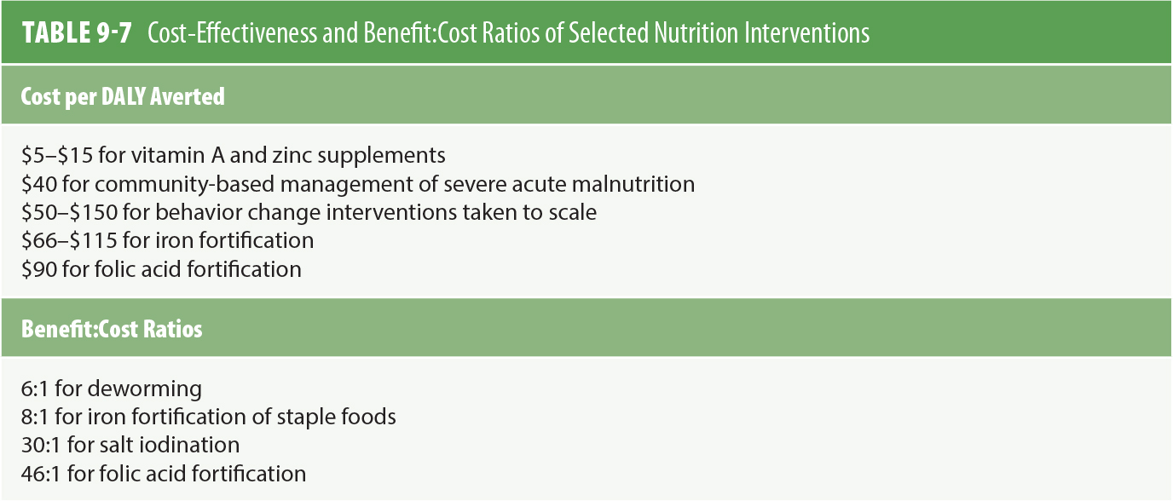
Addressing Future Nutrition Challenges
Data from Horton, S. (2017). Economics of nutritional interventions. In S. de Pee, D. Taren, & M. Bloem (Eds.), Nutrition and health in a developing world (3rd ed., pp.33–45). Totowa, NJ: Humana Press

Slide 44
Addressing Future Nutrition Challenges
Overweight and Obesity (what’s missing? Think E&H)
International organizations can set global nutrition and physical activity standards
Governments can promote campaigns and align national dietary goals with nutritional and agricultural policies
Tax unhealthy foods
Subsidize agricultural production of healthy foods
Legislation can be used to restrict unhealthy food marketing aimed at children
Schools can encourage healthy eating
Adopt national physical activity guidelines and education campaigns
Reduce television viewing and internet usage
Improve safety of recreational spaces

Slide 45
Main Messages
Undernutrition
Nutrition status is a major determinant of health status
Good nutrition is especially critical for the health of pregnant women and children
The most important concerns related to undernutrition are breastfeeding practices and sufficient energy, protein, zinc, iodine, calcium, iron, and vitamin A intake
Increase handwashing to reduce rates of infections and diarrhea
Promote exclusive breastfeeding for 6 months
Ensure pregnant women are well nourished
Support effective programs of supplementation and fortification based on nutrition needs
Focus on SA and SSA and marginalized communities

Slide 46
Main Messages
Overweight and Obesity
Worldwide increase in overweight, obesity, and related chronic diseases are largely driven by globalization, global trade liberalization, economic growth, and rapid urbanization
Some of the most important and cost-effective interventions for overweight and obesity will need to be taken across sectors
Reduce salt intake and eliminate trans-fats in food supply
Reduce SSB consumption through taxation
Increase public awareness through mass media

Slide 47

See you next week
As requested, we will have a session dedicated to essay support.
Please bring a printed copy of your plan, one page, bullet points, NO refs
Make sure that the revised plan relies on your peer’s feedback, the one given by me individually and to the class

